Slide 1
Why Linux
A Linux Distribution has thousands of dollars worth of software for no cost.
Linux is a complete operating system:
Stable - the crash of an application is much less likely to bring down the OS under Linux.
Reliable - Linux servers are often up for hundreds of days compared with the regular reboots required with a Windows system.
Extremely powerful

Slide 2
Why Linux (continued)
Excellent networking facilities
Ideal environment to run servers such as a web server, or an ftp server
A wide variety of commercial software is available if not satisfied by the free software
Easily upgradeable
Supports multiple processors
True multi-tasking, multi-user OS
An excellent window system called X, the equivalent of Windows but much more flexible

Slide 3
Before Linux
In 80’s, Microsoft’s DOS was the dominated OS for PC
single-user, single-process system
Apple MAC is better, but expensive
UNIX is much better, but much expensive.
Only for minicomputer for commercial applications
People was looking for a UNIX based system, which is cheaper and can run on PC
Both DOS, MAC and UNIX are proprietary, i.e., the source code of their kernel is protected
No modification is possible without paying high license fees

Slide 4
GNU Project
Established in 1984 by Richard Stallman, who believes that software should be free from restrictions against copying or modification in order to make better and efficient computer programs
GNU is a recursive acronym for “GNU's Not Unix”
Aim at developing a complete Unix-like operating system which is free for copying and modification
Companies make their money by maintaining and distributing the software, e.g. optimally packaging the software with different tools (Redhat, Slackware, Mandrake, SuSE, etc)
Stallman built the first free GNU C Compiler in 1991.
But still, an OS was yet to be developed

Slide 5

Beginning of Linux
A famous professor Andrew Tanenbaum developed Minix, a simplified version of UNIX that runs on PC
Minix is for class teaching only. No intention for commercial use
In Sept 1991, Linus Torvalds, a second year student of Computer Science at the University of Helsinki, developed the preliminary kernel of Linux, known as Linux version 0.0.1
It was put to the Internet and received enormous response from worldwide software developers
By December came version 0.10. Still Linux
was little more than in skeletal form.

Slide 6
Confrontation and Development
Message from Professor Andrew Tanenbaum
" I still maintain the point that designing a monolithic kernel in 1991 is a fundamental error. Be thankful you are not my student. You would not get a high grade for such a design :-)" (Andrew Tanenbaum to Linus Torvalds)
"Linux is obsolete".
(Remark made by Andrew Tanenbaum)
But work went on. Soon more than a hundred people joined the Linux camp. Then thousands. Then hundreds of thousands
It was licensed under GNU General Public License, thus ensuring that the source codes will be free for all to copy, study and to change.

Slide 7

Linux
Created by Linus Torvalds in 1991
Includes system utilities & libraries from the GNU Project
Open Source Hardware:
Free
Stable
Easily fixed if bugs appear
Why did Linux become popular??
Low-cost alternative in sagging economy
Fear of Microsoft gaining a stranglehold on corporate
Intel loosened its relationship with Microsoft
IBM made an effort to be Linux-compatible

Slide 8
Linux Today
Linux has been used for many computing platforms
PC, PDA, Supercomputer,…
Current kernel version 2.6.13
Not only character user interface but graphical user interface, thanks to the X-Window technology
Commercial vendors moved in Linux itself to provide freely distributed code. They make their money by compiling up various software and gathering them in a distributable format
Red Hat, Slackware, etc
Chinese distribution of Linux also appeared in Taiwan and China - CLE, Red Flag Linux

Slide 9

Linux Has Many Distributions
Notes:
Logos source: http://www.muylinux.com/wp-content/uploads/2009/04/logos-distros.jpg
9

Slide 10
Linux Pros and Cons
Advantages over Windows
It's almost free to relatively inexpensive
Source code is included
Bugs are fixed quickly and help is readily available through the vast support in Internet
Linux is more stable than Windows
Linux is truly multi-user and multi-tasking
multiuser: OS that can simultaneously serve a number of users
multitasking: OS that can simultaneously execute a number of programs
Linux runs on equipment that other operating systems consider too underpowered, e.g. 386 systems, PDA, etc

Slide 11
Linux Pros and Cons
Advantages over Windows
Isn't as popular as Windows
No one commercial company is responsible for Linux
Linux is relatively hard to install, learn and use Linux runs on equipment that other operating systems consider too underpowered, e.g. 386 systems, PDA, etc.
Hence currently, Linux is mainly used in commercial applications, server implementation
More than 75% current network servers are developed based on Linux or Unix systems
– Due to the relatively high reliability

Slide 12
Linux vs. Unix
Linux is free, but Unix is not
Unix is compatible with Linux at the system call level, meaning most programs written for either Unix or Linux can be recompiled to run on the other system with a minimum of work

Slide 13
Linux vs. Microsoft Windows
Both offer
Graphics capabilities
Networking capabilities
But Linux networking is excellent

Slide 14
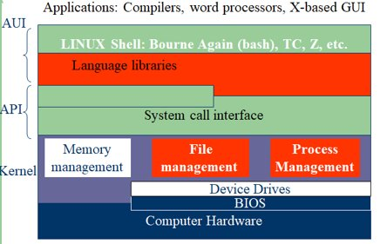
Linux System Architecture
Kernel
The part of an OS where the real work is done
System call interface
Comprise a set of functions (often known as Application Programmer’s Interface API) that can be used by the applications and library routines to use the services provided by the kernel
Application User’s Interface
Interface between the kernel and user
Allow user to make commands to the system
Divided into text based and graphical based
File Management
Control the creation, removal of files and provide directory maintenance
For a multiuser system, every user should have its own right to access files and directories
Process Management
For a multitask system, multiple programs can be executed simultaneously in the system
When a program starts to execute, it becomes a process
The same program executing at two different times will become two different processes
Kernel manages processes in terms of creating, suspending, and terminating them
A process is protected from other processes and can communicate with the others

Slide 15
Linux System Architecture
Memory management
Memory in a computer is divided into main memory (RAM) and secondary storage (usually refer to hard disk)
Memory is small in capacity but fast in speed, and hard disk is vice versa
Data that are not currently used should be saved to hard disk first, while data that are urgently needed should be retrieved and stored in RAM
The mechanism is referred as memory management
Device drivers
Interfaces between the kernel and the BIOS
Different device has different driver
Kernel
A core component of Operating System without which OS can't work
Kernel is the nervous system of OS
It controls everything in OS including I/O Management, Process Management and so on
It is a bridge between applications and the actual data processing done at the hardware level
It acts as an interface between the user applications and the hardware
Notes:
15

Slide 16
Tasks of kernel
Central Processing Unit
The Kernel takes responsibility for deciding at anytime which of the many running programs should be allocated to the processors
Random Access Memory
It is used to store both program instructions and data. Often multiple programs will want access to memory, frequently demanding more memory than the computer has available. The Kernel is responsible for deciding which memory each process can use and determining what to do when not enough memory is available.

Slide 17
Tasks of kernel(Continued..)
Input/output Devices
The Kernel allocates requests from applications to perform I/O to an appropriate device and provides convenient methods for using the device
Memory Management
The Kernel has full access to the system's memory and must allow processes to safely access this memory as they require it
Device Management
A Kernel must maintain a list of available devices. This list may be known in advance configured by the user or detected by the operating system at run time (normally called plug and play)

Slide 18
Tasks of kernel (Continued..)
Scheduling of Process (Dispatching)
Interprocess Communication
Process Synchronization
Context Switching
Manipulation of Process Control Blocks
Interrupt Handling
Process Creation and Destruction
Process Suspension and Resumption

Slide 19
Types of Kernel

Slide 20
Monolithic Kernel
Run in Kernel space every basic system services like
process and memory management,
interrupt handling and I/O Communication,
file system etc in Kernel space
Used by Unix, Linux like Operating systems
Since there is less software involved, it is faster
Every component of the Operating system is contained in the kernel and can directly communicate with each other simply by using function calls.
The Kernel typically executes with unrestricted access to the computer system
This approach provides rich and powerful hardware access

Slide 21
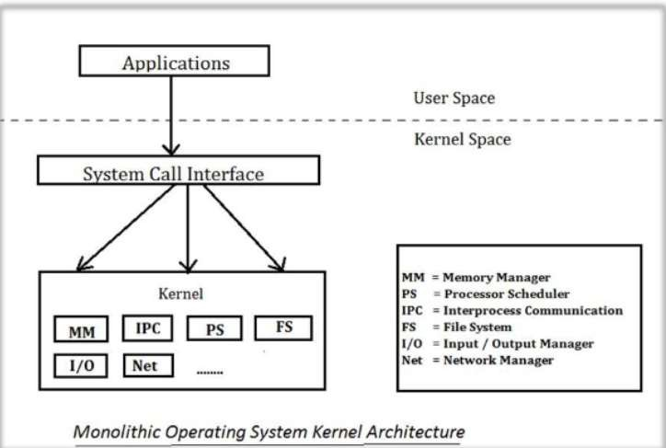
Monolithic Kernel

Slide 22
Pros of Monolithic Kernel
Smaller in source and compiled forms
Less code generally means fewer bugs and security problems is also less
System calls are used to do operations in monolithic kernel
Execution is fast
It has all the things in kernel itself so we don't need any extra mechanism for handling of I/O and process at the time of application making
Notes:
22

Slide 23
Cons of Monolithic Kernel
Coding in kernel space is hard, since you cannot use common libraries
Debugging is harder, rebooting the computer is often needed
Bugs in one part of kernel produce strong side effects
Kernels often become very huge and difficult to maintain
Not portable one. Monolithic kernels must be rewritten for each new architecture that the OS is to be used on.

Slide 24
Micro Kernel
The kernel provides basic functionality that allows the execution of servers and separate programs
The Kernel is broken into separate processes known as server
Some of the servers run in user space and some in kernel space
All servers are kept separate and run in different address spaces
The communication in microkernels is done via message passing
The servers communicate through Interprocess Communication(IPC)
Servers invoke "services" from each other by sending messages
It is also possible to dynamically switch among operating systems and to have more than one active simultaneously

Slide 25
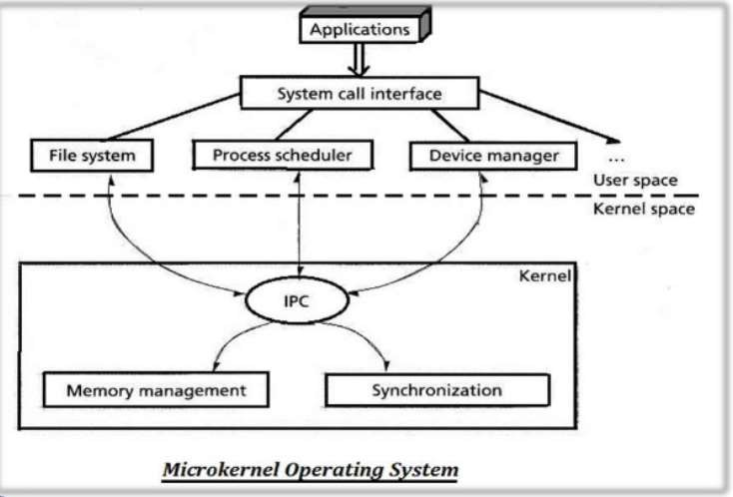
Micro Kernel

Slide 26
Advantages of Micro Kernel
Easier to maintain than Monolithic Kernel
Crash resistant (If one server fails, other servers can still work efficiently)
Portable
Smaller in size
Contains smaller amount of code. It increases stability and security.

Slide 27
Key Comparisons
Basis for Comparison | Micro Kernel | Monolithic Kernel
Size | Smaller in size | Larger than microkernel
Execution | Slow | Fast
Extendible | Easy to extend | Hard to extend
Security | If a service crashes, it does effects on working on the microkernel | If a service crashes, the whole system crashes in monolithic kernel
Code | To write a microkernel more code is required | To write a monolithic kernel less code is required
Example | QNX, Symbian, L4Linux etc. | Linux, BSDs(FreeBSD, OpenBSD, NetBSD)etc.

Slide 28
Topics
Introduction to Linux
File System of the Linux
General usage of Linux kernel & basic commands
Linux users and group
Permissions for file
Directory and users
Searching a file & directory
Zipping and Unzipping concepts
Linux for the Industry 4.0 Era
OPENIL and its advantages
Features of OPENIL

Slide 29
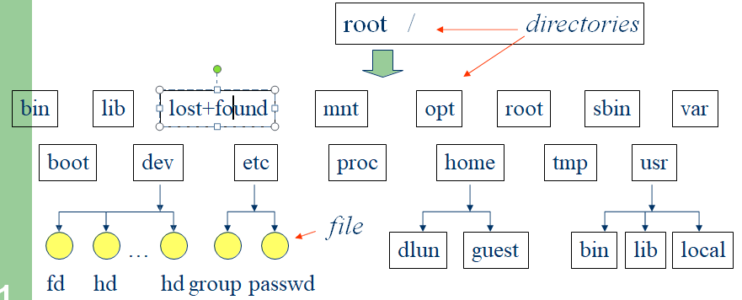
Linux File System Structure
According to the File System Standard (FSSTND) proposed in 1994, every LINUX system should contain a set of standard files and directories
Kernel
Notes:
29

Slide 30
Linux File System Structure
Root Directory ( / )
Top of the file system. Similar to \ in DOS
/bin
Contain the binary (executable code) of most essential Linux commands, e.g. bash, cat, cp, ln, ls, etc.
/boot
Contain all the files needed to boot the Linux system, including the binary of the Linux kernel. E.g., on Red Hat Linux 6.1, the kernel is in /boot/vmlinux-2.2.5-15 file
/dev
Contain the special files for devices, e.g. fd0, hd0, etc.
Kernel
Notes:
30

Slide 31
Linux File System Structure
/etc
Contain host-specific files and directories, e.g. information about system configuration
/etc/passwd
This file contains login information of users in the system
For every user, one line of record is stored in the following format:
login_name : dummy_or_encrypted_password : user_ID :
group_ID : user_info : home_directory : login_shell
Notes:
31

Slide 32
Linux File System Structure
E.g. rahul:x:134:105:MohanARahul:/home/rahul:/bin/bash
rahul : login name
x : means that it is a dummy password. The encrypted password is stored in /etc/shadow. This field can also be used to store the actual encrypted password. In any case, the original (unencrypted) password cannot be seen by anyone, including the administrator
134 : a user id given to that user. Range from 0 to 65535.
0 is assigned to super-user. 1 to 99 are reserved
105 : a group id given to that user to indicate which group he belongs to. Range from 0 to 65535. 0 to 99 reserved
Mohan A Rahul : user info, usually user’s full name
/home/rahul : home directory of the user
/bin/bash : the location of the shell the user is using
Notes:
32

Slide 33
Linux File System Structure
/home
Contain the home directories of every user in the system, e.g. dlun, guest, etc
/lib
Store all essential libraries for different language compilers
/lost+found
Contain all the files on the system not connected to any directory.
System administrator should determine the fate of the files in this directory
Notes:
33

Slide 34
Linux File System Structure
/mnt
Use by system administrator to mount file systems temporarily by using the mount command
Before using any devices, they have to be mounted to the system for registration
For example, after mounting a CD-ROM, the file system in it will be mapped to /mnt/cdrom directory
User can then read and write files in the CD-ROM by accessing this directory
Similar to mapping a drive letter to a CD-ROM in Windows
Different from the special file in /dev. Special file is only a place where data of the CD-ROM is transferred or stored. No file system concept
Notes:
34

Slide 35
Linux File System Structure
/opt
Use to install add-on software packages, e.g. star office, etc.
/proc
Contain process and system information
/root
Home directory of the user root, usually the administrator
/sbin
The directories /sbin, /usr/sbin, and /usr/local/sbin contain system administration tools, utilities and general root only commands, such as halt, reboot and shutdown
Notes:
35

Slide 36
Linux File System Structure
/tmp
Contain temporary files. Usually files in this directory will be deleted from time to time to avoid the system fills with temp files
/usr
One of the largest sections of the Linux file system
Contain read-only data that are shared between various users, e.g. the manual pages needed for the command man. Stored in /usr/man direcrtory
/var
Contain data that keeps on changing as the system is running. E.g. /var/spool/mail directory keeps the mail of user
Notes:
36

Slide 37
Topics
Introduction to Linux
File System of the Linux
General usage of Linux kernel & basic commands
Linux users and group
Permissions for file
Directory and users
Searching a file & directory
Zipping and Unzipping concepts
Linux for the Industry 4.0 Era
OPENIL and its advantages
Features of OPENIL

Slide 38
Linux Shell
whoami
Shell interprets the command
and request service from kernel
Similar to DOS but DOS has only one set of interface while Linux can select different shell
– Bourne Again shell (Bash), TC shell (Tcsh), Z shell (Zsh)
Different shell has similar but different functionality
Bash is the default for Linux
Graphical user interface of Linux is in fact an application program work on the shell
pwd
ls
Bash, Tcsh, Zsh
Kernel
Notes:
38

Slide 39
Example Linux Shell Commands
Frequently used commands available in most shells:
ls : to show (list) the names of the file in the current directory
cd : change directory,
– e.g. cd /
cd ..
change to the root directory
change to the parent of that directory
cp : copy one file to another
– e.g. cp abc.txt xyz.txt
copy abc.txt to xyz.txt
rm : remove a file
Notes:
39

Slide 40
Example Linux Shell Commands
man : ask for the manual (or help) of a command
– e.g. man cd ask for the manual of the command cd
pwd : show the name of the present working directory
cat : to show the content of a text file
– e.g. cat abc.txt show the content of abc.txt
whoami : to show the username of the current user
More Linux/Unix commands
Kernel
Notes:
40

Slide 41
Topics
Introduction to Linux
File System of the Linux
General usage of Linux kernel & basic commands
Linux users and group
Permissions for file
Directory and users
Searching a file & directory
Zipping and Unzipping concepts
Linux for the Industry 4.0 Era
OPENIL and its advantages
Features of OPENIL

Slide 42
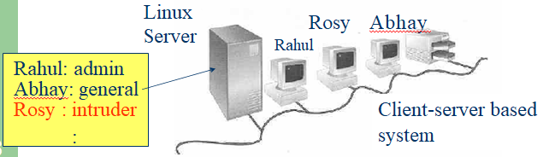
Linux User Login
Linux is a multiuser OS
Allow multiple users to use the resource of a computer at the same time
Every user needs to login the system with the password provided to identify their right in using the resource
Require for both client-server based system or desktop
Notes:
42

Slide 43
Linux User Interface
Traditional Linux (Unix also) uses command- driven interface (or text-based interface)
User need to type lines of command to instruct the computer to work, similar to DOS
Advantage: fast in speed. Very few resource is required for its implementation
Disadvantages: user needs to type, hence can easily make error. Besides, user needs to memorize all commands
Suitable for expert users and for the systems that interaction with user is not frequent, such as servers
19
Notes:
43

Slide 44
Linux User Interface
By adopting the X-Window technology, graphical user interface (GUI) is available for Linux:
Uses pointing devices (e.g. mouse) to control the system, similar to Microsoft’s Windows
Provide menu-driven and/or icon-driven interfaces
menu-driven: user is provided with a menu of choices. Each choice refers to a particular task
icon-driven: tasks are represented by pictures (icon) and shown to user. Click on an icon invokes one task
Advantages: No need to memorize commands.
Always select task from menus or icons
Disadvantages: Slow and require certain resource for its implementation
Suitable for general users and systems, such as PC
Notes:
44

Slide 45
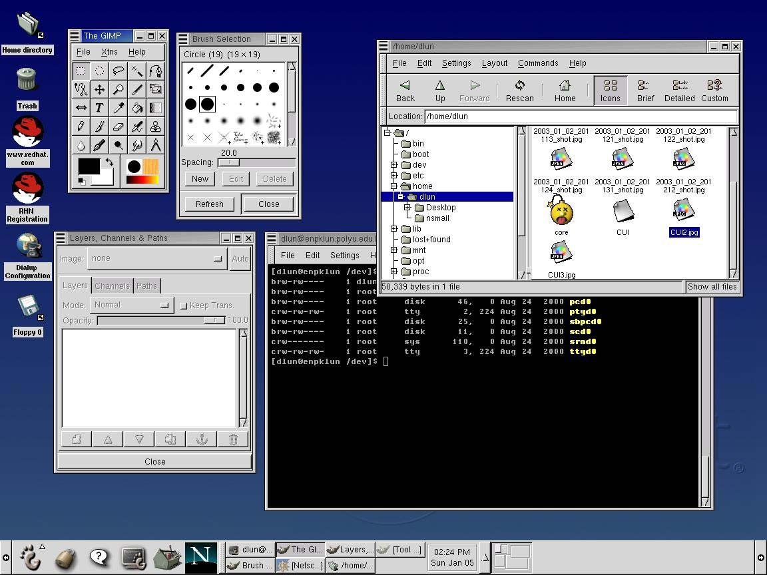
Linux User Interface
A typical Linux GUI based on
GNOME
Similar to Microsoft’s Windows, however, different window systems can be chosen (e.g. GNOME, KDE, etc)
Notes:
45

Slide 46
Topics
Introduction to Linux
File System of the Linux
General usage of Linux kernel & basic commands
Linux users and group
Permissions for file
Directory and users
Searching a file & directory
Zipping and Unzipping concepts
Linux for the Industry 4.0 Era
OPENIL and its advantages
Features of OPENIL

Slide 47
File Management
In Linux, file is defined as simply the thing that deals with a sequence of bytes
Hence everything are files
– An ordinary file is a file; a directory is also file; a network card, a hard disk, any device are also files since they deal with a sequence of bytes
Linux supports five types of files
simple/ordinary file (text file, c++ file, etc)
directory
symbolic (soft) link
special file (device)
named pipe (FIFO)
Kernel
Notes:
47

Slide 48
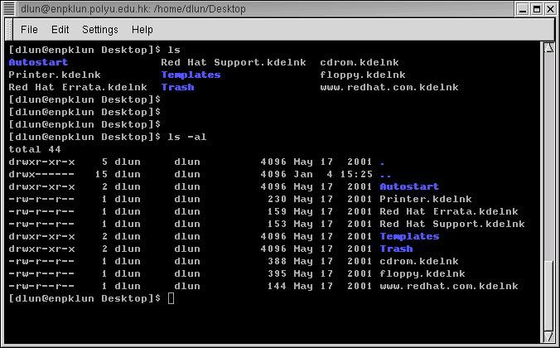
Example Linux File
Kernel
Names in blue are directories, indicated by a letter d at the beginning of the line
Notes:
48

Slide 49
Linux File
Symbolic (soft) link
Not a real file, just a link to another file
Allow giving another name to a file without actually duplicates it – hence save memory space
Special file (device)
Each hardware device, e.g. keyboard, hard disk, CD-ROM, etc is associated with at least one file
Usually stored in /dev directory
Applications can read and write any devices by reading and writing their associated file – hence the access method is known as device independent
Divide into two types: character special files, e.g. keyboard, and block special files, e.g. disk
Kernel
Notes:
49

Slide 50
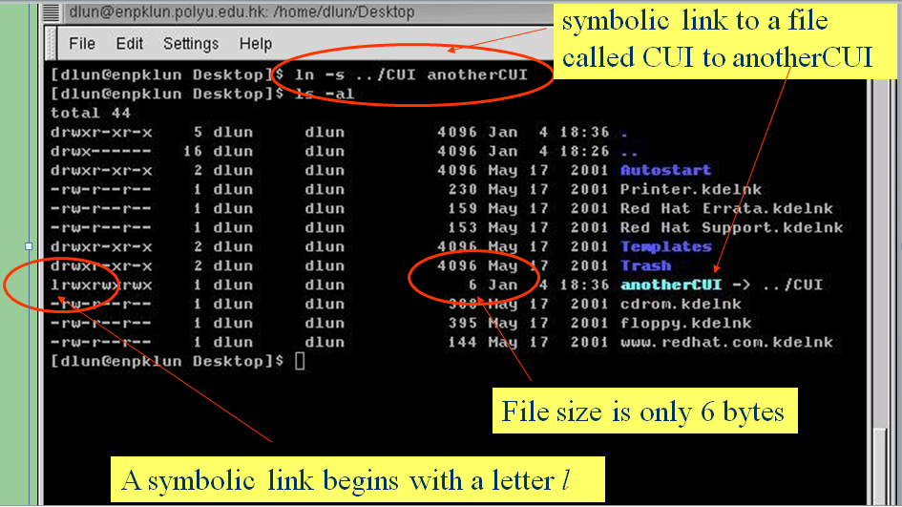
Linux File
Kernel
Notes:
50

Slide 51
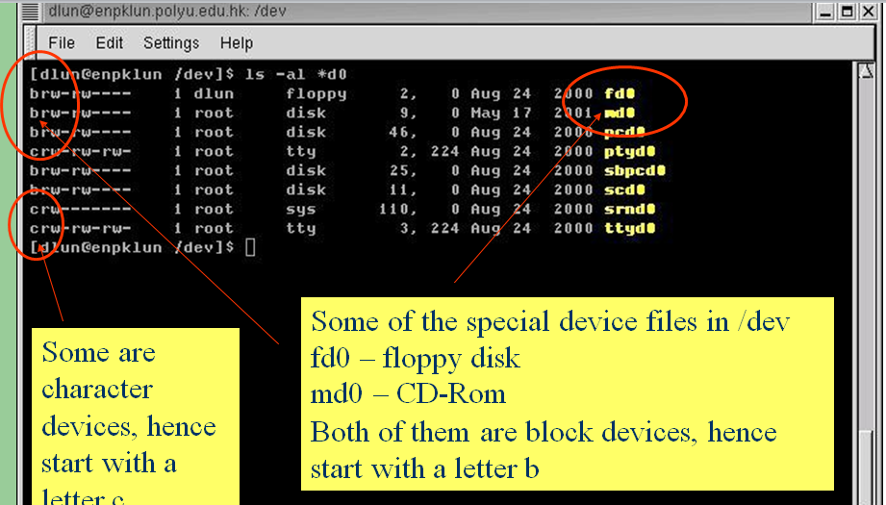
Linux File
Kernel
Notes:
51

Slide 52
Linux File Access Privilege
Linux is a multiuser system, the files of all users are stored in a single file structure
Mechanism is required to restrict one user to access the files of another user, if he is not supposed to
User can impose access permission to each file to restrict its access
The term “access permission” refers to
read permission
write permission
execute permission
Notes:
52

Slide 53
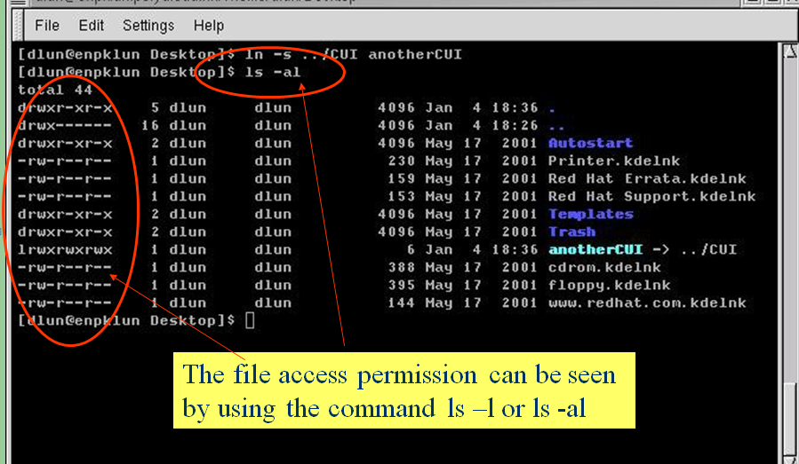
Linux File Access Privilege
Notes:
53

Slide 54
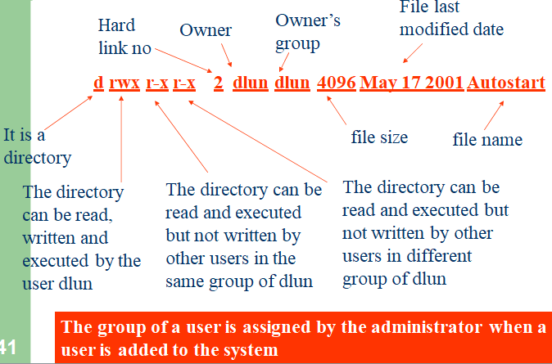
Linux File Access Privilege
Notes:
54

Slide 55
Linux File Access Privilege
Access permission can also be assigned to a directory
Directory is also a file that contains the attributes of the files inside it.
If read permission is not given to a directory
cannot show the structure of this directory
e.g. cannot use ls
If write permission is not given to a directory
cannot modify anything of the directory structure
e.g. cannot copy a file into this directory since it will modify the directory structure by adding one more file
If execute permission is not given to a directory
nearly nothing can be done with this directory, even cd
Notes:
55

Slide 56
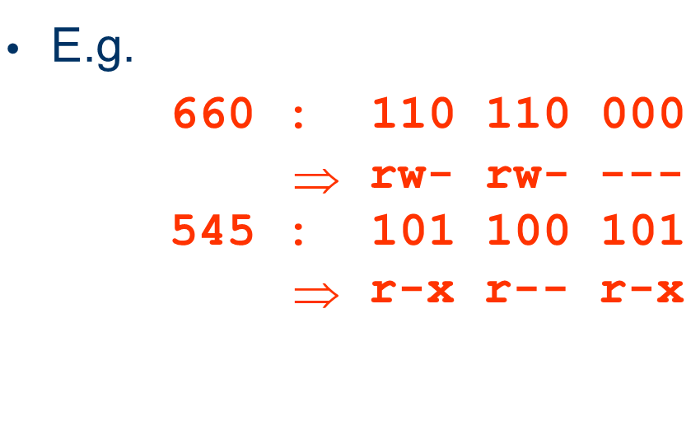
Linux File Access Privilege
The access permission of a file or directory can be changed by using the command
chmod xyz filename/directory name
xyz refers 3 digit in octal form
Notes:
56

Slide 57
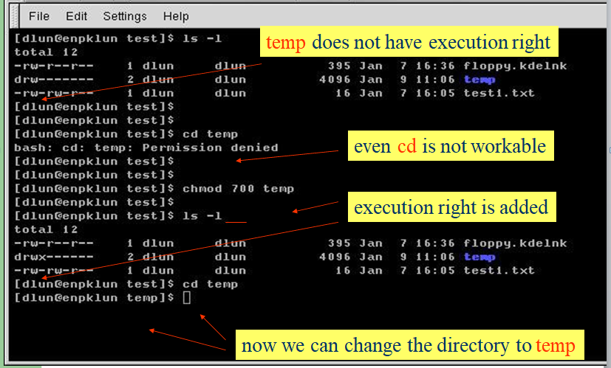
Linux File Access Privilege
Notes:
57

Slide 58
Symbol | Meaning
u | User
g | Group
o | Other
a | All
r | read
w | Write
x | Execute
+ | Add permission
- | Take away permission

Slide 59
Topics
Introduction to Linux
File System of the Linux
General usage of Linux kernel & basic commands
Linux users and group
Permissions for file
Directory and users
Searching a file & directory
Zipping and Unzipping concepts
Linux for the Industry 4.0 Era
OPENIL and its advantages
Features of OPENIL

Slide 60

Searching for Binary Files
$ which <binary file>
If you are able to run a binary file and want to know where does this binary exist
$ which shutdown
Note that this command searches for the binary using the $PATH environment variable
This means if the $PATH does not have the folder of the binary,
which will not be able to find it
In other words, if you can not run the command, which will not be able to locate it

Slide 61
Searching for Binary Files
$ locate <filename>
$ locate <part of the path or filename>
The locate command searches for the required file based on a pre- prepared database of all files in the system along with their full path
When performing a search using locate command, the database is searched for the passed string
Hence, you can search based on any string, even if it is only a part of the file path
$ locate in/zi
This would result in,
/usr/bin/zip
/usr/bin/zipcloak
/usr/bin/zipsplit

Slide 62
Database for “locate”
The database used by the locate command is created by the program updatedb
This program runs in a cron job that periodically (such as once daily) updates the database
Accordingly the database may have incorrect or incomplete info,
Newly created files may not be in the database for sometime
Recently deleted files may still be in the database
Recently moved files, may be in the database using its old location
This means that these changes will be missed in the search
If you want to update the index manually,
$ sudo updatedb

Slide 63
Limitation of “locate” Command
The locate command is a very useful command because:
It is very simple
You can search for a file based on its name, part of its name, part of its path, …etc
It is very fast command (because it uses a pre-prepared database)
However, it comes with some limitations,
It can only search based on file name (or path name)
It may not find new files
It may result in wrong results since it does not use the current tree in its search (instead it uses an old snapshot of the tree)
The locate command is useful for searching for system files or traditional Linux files but can not be used in a lot of other scenarios

Slide 64
A Smarter Search (find Command)
The find is a very rich command that can search on files using different search filters, for example,
Search for a file based on its name
Search for a file based on its size
Search for a file based on its last modification date
Search for a file based on its type (normal file, directory, symbolic link, ….)
Search for a file based on other criteria
A combination of all of those search criteria
Limit the search scope to a certain directory (and its subdirectories)
Skip Some subdirectories from the search scope
This command also allows for performing an action on all the files that match the search criteria

Slide 65
Selecting the Search Scope
The find command perform its search within the given scope
For example:
$ find ~
This will list all files in the home directory and its subdirectories
$ find ~ | wc -l
Count files under my home directory
$ find /
List all files in the system starting from the root directory
You may need to run this command with sudo to be able to search all files
$ find /bin /sbin /usr/bin
List all files in those 3 directories (scope can contain multiple directories)
$ find ~/Documents | grep “.pdf”
Find all pdf files under the Documents folder
$ find . > file-list.txt
Store a list of files under the current directory in the specified file

Slide 66
Adding Filters to the Search
So far, the find command finds all the files in the specified path, and lists them
To limit the search to some files, we had to pipe the result to the grep command
This gives a similar effect to the locate command (except that it is up to date)
But we need more search options than searching by the filename or the path
To do that, we need to add Search Filters to the find command

Slide 67
Searching by File Type
$ find <scope> -type <type>
To generate a list of directories in the user home directory
$ find ~ -type d
To generate a list of files only in the user home directory
$ find ~ -type f
To generate a list for all symbolic links in the system,
$ find / -type l
For Device files
$ find / -type c (character devices)
$ find / -type b (block device)

Slide 68
Searching by File Name
$ find <scope> -name <file name pattern>
$ find <scope> -iname <file name pattern>
To search for a file by its name
$ find ~ -name my-file.txt
You can use a pattern for the file name (or even a regular expression)
$ find ~ -name “*.xml”
$ find ~ -name \*\.xml
For case insensitive search,
$ find / -iname “*.html”
$ find / -iname \*\.html

Slide 69
Searching by File Size
$ find <scope> -size <file Size filter>
You can search by file size
$ find ~ -size +1M
• + means bigger than
- means smaller than
Neither means, exactly this size
M means Megabyte
G means Gigabyte
K means Kilobyte
w means words (2 bytes)
c means characters (1 byte)
b means blocks (512 byte), this is the default, if no unit is passed

Slide 70
And Much More
The find command is a very rich command, and its use is not limited to the described scenarios
Filters can be also using date of creation, date of modification, owning user, owning group, permissions, etc …
Examples:
$ find ~ -perm 777
$ find . -user root
$ sudo find / -mtime -50
$ sudo find / -atime

Slide 71
Mixing Search Criteria
You can use multiple search filters to get a more sophisticated search criteria as follows,
To have multiple conditions “ANDed” together, which means a match happens only if all the conditions are satisfied
To have multiple conditions “ORed” together, which means a
match happens if any of the conditions is satisfied
You can have any of the conditions reversed
You can have a more complicated search expressions using
parentheses

Slide 72
Using Multiple “ANDed” Filters
You can have “ANDed” filters, in which a file match has to satisfy all the criteria
Just put the filters back to back
$ find ~ -type f -name “*.jpg” -size +10M
Use ‘-a’
$ find ~ -name ‘*.jpg’ -a -size +10M
Use ‘-and’
$ find ~ -name ‘*.jpg’ -and -size +10M

Slide 73
Using Multiple “ORed” Conditions
You can have “ORed” filters, in which a file match needs to satisfy any one of the filters
Use ‘-o’
$ find ~ -name ‘*.jpg’ -o -size +10M
Use ‘-or’
$ find ~ -name ‘*.jpg’ -or -size +10M

Slide 74
Inverting Conditions
You can have one of the filters inverted in the search criteria
Using “!”
$ find ~ \! -name “*.pdf”
Using “-not”
$ find ~ -not -name “*.pdf”

Slide 75
Mix & Match
You can mix and match any of the filters described so far to get a more sophisticated filter expression
The use of parentheses “( )” becomes necessary as the expression gets more complicated
Keep in mind that the parentheses need to be escaped
Use \( expression \)
Example:
$ find ~ \( -name tmp -o -name \*.txt \)
$ find ~ \( -name tmp -o \( -not -user root\) \)

Slide 76
Find & Perform Action
The default action for the find command is to print the list of files matching the search criteria (file name with full path)
However, you can set another action to apply on those files that meet the search criteria
Print the names with path (Default action)
$ find ~ -type d -print
Delete the files
$ find ~ -name “*.pdf” -delete
Perform a detailed list of the files
$ find ~ -size +10M -ls
Quit the search on the first match. This can be used if the purpose of the search is to just find if any file meets this criteria
$ find ~ -size +100M -quit

Slide 77
Skipping Files (The -prune Action)
The find command performs its search recursively in all sub- directories
In case we need to skip some search results, we can use a search filter with the -prune action with the other search filters
Example:
$ find ~ -type l -prune -o -name "*.txt" -print
$ find . -path ./misc -prune -o -name '*.txt' -print
$ find . -type d \( -path dir1 -o -path dir2 -o -path dir3 \) -prune -o -print

Slide 78
Topics
Introduction to Linux
File System of the Linux
General usage of Linux kernel & basic commands
Linux users and group
Permissions for file
Directory and users
Searching a file & directory
Zipping and Unzipping concepts
Linux for the Industry 4.0 Era
OPENIL and its advantages
Features of OPENIL

Slide 79
ZIP command
ZIP is a compression and file packaging utility for Unix.
Each file is stored in single .zip {.zip-filename} file with the extension .zip.
The zip program puts one or more compressed files into a single zip archive, along with information about the files (name, path, date, time of last modification, protection, and check information to verify file integrity). An entire directory structure can be packed into a zip archive with a single command.
Compression ratios of 2:1 to 3:1 are common for text files.
zip has one compression method (deflation) and can also store files without compression.
zip automatically chooses the better of the two for each file to be compressed.

Slide 80
ZIP Command
Syntax
zip [options] zipfile files_list
Extracting from .zip
Unzip <filename.zip>
Possibilities:
-d removes files from a zip archieve
Zip –d <filename.zip> <file.txt>
-u updates a file in zip archieve
Zip –u <filename.zip> <file.txt>
3. -m deletes original files after zipping
Zip –m <filename.zip> file.txt
4. -r recursively zips files in a directory
Zip –r <filename.zip> <directory_name>
5. -v verbose mode or prints diagnostic information
Zip –v <filename.zip> <file1.txt>

Slide 81
Gzip/gunzip Command
Another popular compression algorithm that allows to reduce the size of a file and keep original file mode, ownership and timestamp.
.gz file format and uses gzip utility to compress and decompress files
By default, gzip keeps the original file name and timestamp in the compressed file
Syntax:
gzip <test.txt>
Shall create a <test.txt.gz> and delete the original file
For compress multiple files or directory into one file, first you need to create a Tar archive and then compress the .tar file with Gzip. A file that ends in .tar.gz or .tgz is a Tar archive compressed with Gzip.

Slide 82
Gzip/gunzip Command​
Gunzip synopsis
gunzip [ -acfhlLnNrtvV ] [-S suffix] [ name ... ]
gunzip also recognizes the special extensions .tgz and .taz as shorthands for .tar.gz and .tar.Z respectively.
Possibilities:
-k allows to keep original file
Gzip –k <filename>
Or –c
Gzip –c <filename> > filename.gz
-v prints the percentage reduction and name of files processed
Gzip –v <filename>
3. Compress multiple files
Gzip <file1> <file2> <file3>

Slide 83
gzip OPTIONS
-f –force
Force compression or decompression even if the file has multiple links or the corresponding file already exists

Slide 84
gzip OPTIONS
-l –list
For each compressed file, list the following fields:
compressed size: size of the compressed file
uncompressed size: size of the uncompressed file
ratio: compression ratio (0.0% if unknown)
uncompressed_name: name of the uncompressed file
-n --no-name
When compressing, do not save the original file name and time stamp by default.
When decompressing, do not restore the original file name if present (remove only the gzip suffix from the compressed file name) and do not restore the original time stamp if present.

Slide 85
gzip OPTIONS
change the compression level
-# --fast –best
Regulate the speed of compression using the specified digit #
-1 or --fast
indicates the fastest compression method, less compression
-9 or --best
indicates the slowest compression method
best compression
The default compression level is-6
That is, biased towards high compression
Gzip –9 <filename>

Slide 86
gzip decompression
Compressed files can be restored to their original form using:
gzip -d or
Gunzip or
Zcat
Gzip –d <filename.gz>
gunzip can currently decompress files created by gzip, zip, compress, compress -H or pack.
The detection of the input format is automatic.
gzip and gunzip can also compress or decompress data from standard input and output
ls -laR $HOME | gzip > filelist.gz
Or by using –c option

Slide 87
Linux Command bzip2
bzip2, bunzip2
a block-sorting file compressor, v1.0.2
bzcat
decompresses files to stdout
bzip2recover
recovers data from damaged bzip2 files
on the average about 10-20% better than gzip
– at the expense of longer compression times
Output with .bz2 filename extension

Slide 88
bzip2: Synopsis
bzip2 [ -cdfkqstvzVL123456789 ] [ filenames ... ]
bunzip2 [ -fkvsVL ] [ filenames ... ]
bzcat [ -s ] [ filenames ... ]
bzip2recover filename
Each file is replaced by a compressed version of itself, with the name "original_name.bz2“
https://www.geeksforgeeks.org/bzip2-command-in-linux-with-examples/
https://www.javatpoint.com/linux-bzip2-bunzip2
https://www.javatpoint.com/linux-bzcat-bzmore
https://www.geeksforgeeks.org/tar-command-linux-examples/

Slide 89
bzip2 OPTIONS
-c –stdout
(as in gzip) Compress or decompress to standard output.
-t –test
Check integrity of the specified file(s), but don't decompress them.
This really performs a trial decompression and throws away the result.
-k –keep
Keep (don't delete) input files during compression or decompression.

Slide 90
bzip2 OPTIONS
-s –small
Reduce memory usage, for compression, decompression and testing.
-1 (or --fast) to -9 (or --best)
Set the block size to 100 k, 200 k .. 900 k when compressing.
Has no effect when decompressing.

Slide 91
bzip2 decompression
bzcat
decompresses files to stdout
bunzip2
Cannot use bunzip2 to uncompress files compressed with gzip and vice versa
bzip2 -d
decompresses all specified files.
Files which were not created by bzip2 will be detected and ignored
warning issued.

Slide 92
bzip2 decompression
filename.bz2 filename.bz filename.tbz2 filename.tbz anyothername
filename filename filename.tar filename.tar
anyothername.out

Slide 93
Linux Command: tar
tar is a general-purpose archiving utility
Stands for Tape Archive
capable of packing many files into a single archive file,
while retaining information needed to restore the files fully, such as file permissions and ownership.

Slide 94
tar options
-c
Create a new archive
-x
Extract files from an archive
-t
List table of contents to an archive
-r
append

Slide 95
tar options
-u
Update files
-d
Compare files in the archive to those in the file system
-v
– print verbose information
-k
To keep any existing files when extracting
B filename
To specify that the tar file to be read or written is filename.

Slide 96
Other commands
Synopsis:
compress [ -f ] [ -v ] [ -c ] [ -V ] [ -r ] [ -b bits ] [ name ... ]
uncompress [ -f ] [ -v ] [ -c ] [ -V ] [ name ... ]
zip [-aABcdDeEfFghjklLmoqrRSTuvVwXyz!@$] [- b path] [-n suffixes] [-t mmddyyyy] [-tt mmddyyyy] [ zipfile [ file1 file2 ...]] [-xi list]
unzip [-Z] [-cflptuvz[abjnoqsCLMVX$/:]] file[.zip] [file(s) ...] [-x xfile(s) ...] [-d exdir]

Slide 97
Topics
Introduction to Linux
File System of the Linux
General usage of Linux kernel & basic commands
Linux users and group
Permissions for file
Directory and users
Searching a file & directory
Zipping and Unzipping concepts
Linux for the Industry 4.0 Era
OPENIL and its advantages
Features of OPENIL

Slide 98
OPENIL
It is an open source software platform for industrial automation
It provides following features:
Secure:
Industrial-grade security
Trusted computing
Hardened software
Cryptographic operations
End to end security
Real-Time
OpenIL provides a true real-time software platform
Real-time Linux kernel, professionally developed, tested and validated
Deterministic
OpenIL supports the latest Time-Sensitive Networking technology.
OpenTSN architecture runs on various hardware.
Go on to OPENIL website

Slide 99
OPENIL Advantages
100% OPEN SOURCE
Linux distribution specifically developed, tested, and packaged for industrial systems
CROSS PLATFORM
True cross-platform software platform, not limited to specific device or hardware architecture
INDUSTRY LEADING EXPERTS
Technology experts and developers from industry-leading companies are actively building OpenIL software and solutions

Slide 100
OPENIL Advantages
WELL DOCUMENTED AND SUPPORTED
Development and user manuals are well documented with active community support.
FIELD PROVEN
Every release is rigorously tested in industrial environments on production systems.
CONTINUOUSLY EVOLVING
OpenIL targets broad industrial applications, and is always evolving.
Go on to the OPENIL website

Slide 101
Summary
Linux is an operating system that is built by a community of software developers around the world and led by its creator, Linus Torvalds
It is derived originally from the UNIX operating system, but has grown beyond UNIX in popularity and power over the years
Most Linux software projects are protected by one of a set of licenses that fall under the Open Source Initiative umbrella. The most prominent of these is the GNU Public License (GPL)
The GNOME desktop environment has become the default desktop environment for many Linux systems, including Fedora and RHEL

Slide 102
Summary
To become an expert Linux user, you must be able to use the shell to type commands
Commands for moving around the filesystem, copying files, moving files, and removing files are among the most basic commands you need to work from the shell
Use the locate and find commands for finding files and grep for searching files

Slide 103
Linux Usage in Industry
Internet
Major players like Amazon, Google and Netflix all rely on Linux for delivering services
Facebook and Twitter each use a Linux variant that has been tweaked in-house
Finance
A number of markets trade using solutions built on a Linux stack, including the Wall Street, NYSE Euronext, London Stock Exchange and Chicago Mercantile Exchange

Slide 104
Linux Usage in Industry
Insurance
AIG uses Red Hat and SUSE variants in its architecture
Health insurer, Cigna, uses Red Hat to build operating environments on Linux
Healthcare
Red Hat skills come in handy for Linux system administration jobs at healthcare organizations such as Beth Israel Deaconess Medical Center
Many Debian “pure blends” — subsets of the Debian GNU/Linux distribution — address the specific needs of healthcare providers and researchers by packaging the kernel with drug databases or electronic medical record systems

Slide 105
Linux Usage in Industry
Other Industries
Government, education and military are other sectors increasing their reliance on Linux system administration
Innovative companies using Linux systems to support advances in autonomous vehicles, wearable devices, and other “smart” combinations of hardware and software
Startups and smaller businesses often choose the open-source OS for their operating servers because so many distributions are freely available

Slide 106
Job Positions
DevOps Engineer
Java Developer
Software Engineer
Systems Administrator
Systems Engineer
Senior Software Engineer
Python Developer
Network Engineer
Software Developer
Linux Engineering Admin
Software Developer
Linux Engineer
TechOps Engineer
Senior Java Developer
Build release management Engineer

Slide 107
Linux Certifications
Most of the hiring manager are looking to recruit Linux professionals.
The emergence of open cloud platforms is creating increasing demand for Linux professionals who have the right expertise
Linux-certified professionals always be a better position in the job market
Employers are looking for more Linux talent.
Better salary increments for Linux certified professionals

Slide 108
Linux Certifications
Some of the best Linux certification are given below:
Linux Foundation
Red Hat Linux SuSE Linux
Oracle
Linux Professional Institute (LPIC)
CompTIA
Check it

